Slide 1
Coding Challenge Solutions Part 1
Angel Hernandez – May 19, 2018

Slide 2
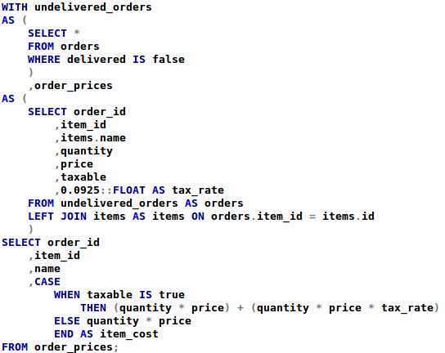
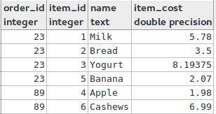
Question 1: Find the order total (the sum of individual item prices for all items in an order) for all undelivered orders in the orders table.
We make the assumption that since a taxable is included we need to also calculate our order total with Sales Tax included. We use the current Sales Tax in Berkeley for this exercise.

Slide 3


Question 2: How would you find the order total (defined above) and the average order total per customer?
We use the results of question 1 and simply use the sum and average functions.

Slide 4
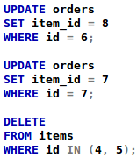
Question 3: There are duplicates in the items table. Before deleting the duplicate records from the table, we need to update the orders.item_id field to ensure that there are no references to the records we're going to delete. Write a query to update the orders table to swap the item_id values if necessary. What do you think is reasonable business logic to determine which duplicate record to keep?
It looks like duplicate items are created as the price changes.
I made the assumption that as new records are inserted into the items table the id increments by 1. So the newest record would have the larger id number.
  A more reasonable approach to this would be to update the size, price, and sold_by column data using an UPDATE query.
  Alternatively, we could have an additional column with a flag that indicates which product price is active. We could then utilize this flag in subsequent queries to filter to the active price.
Based on the assumption, I removed the records with Id 4 and 5, and I updated the Orders table so that Item Id 4 and 5 became 7 and 8, respectively.

Slide 5
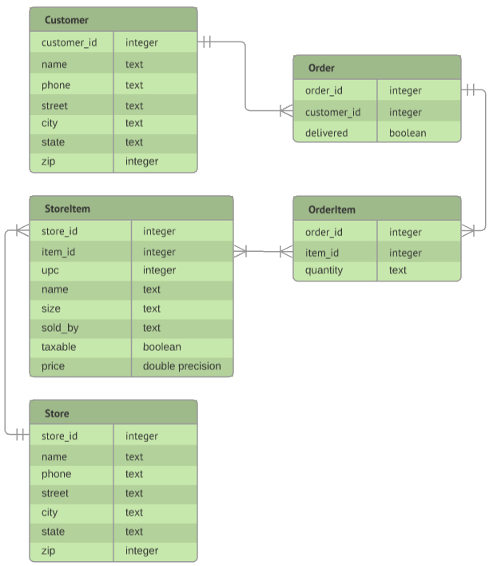
Question 4: Suppose you were redesigning the model for these tables. Let's say that we were expanding and now need to support variations in pricing and availability across locations. What changes would you make and why? We're looking more for discussion and diagrams for this question and not necessarily SQL.
When looking the the initial Orders table we see that two distinct pieces of information are available in this table: Customer Information and Order Information
  We break out the Customer information into it’s own table so we can track and catalog customers as their own entity
When looking at the remaining information we see that the data can be further split out into Order and OrderItem.
  Order contains a Customer Id to Order Id mapping for every order that a customer places along with their delivery status
  OrderItem contains the Order Id to Item Id mapping which tells us what items belong to an order along with the associated item quantity
We ignore scaling for now. If we want to include variations in pricing and store availability, then we need an Item to Store table and a Store table
  StoreItem contains the Store Id to Item Id mapping along with all the Item data (UPC, Name, Size, etc.)
    We include this all together because a particular item in one store may be sold differently at another (i.e., per item or per pound)
  Store contains all of the information about the different stores where items are being sold. This is similar to the Customer table
This model allows us to break up the data into distinct entities and avoids duplicating information when it is not necessary. For instance, we don’t need to see the customer name, address, and phone number in every order. We only need an id, and that tells us how we can map it to the customer table
The next two slides will spend time discussing alternatives to the way we track pricing and availability variations.

Slide 6
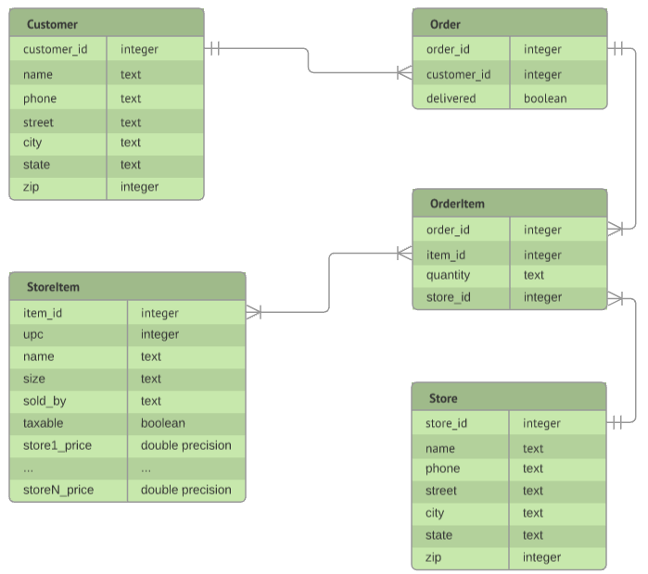
Question 4 (Continued): Suppose you were redesigning the model for these tables. Let's say that we were expanding and now need to support variations in pricing and availability across locations. What changes would you make and why? We're looking more for discussion and diagrams for this question and not necessarily SQL.
This model pivots the store pricing options by including a column for each store in the Store table. Additionally, this model includes the Store Id in the OrderItem table so that we can know what store the order will come from.
Pros
  We avoid duplication of items across stores in the StoreItem table.
  This view may be beneficial from a reporting perspective
Cons
  As we add new stores we will have to continually add new columns to the StoreItem table
  This model makes the assumption that all stores sell a particular item by the same size.
  It would be very difficult to calculate the cost of Orders since we need to know what column we have to use based on the Store Id in the OrderItem table
    It is possible that the process which calculates this could do it dynamically, but it would require unnecessary effort

Slide 7
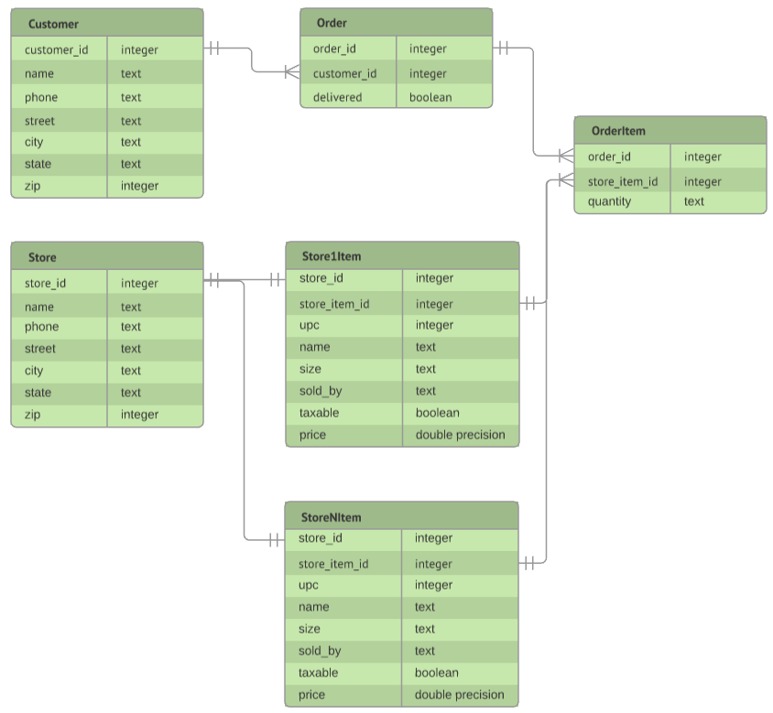
Question 4 (Continued): Suppose you were redesigning the model for these tables. Let's say that we were expanding and now need to support variations in pricing and availability across locations. What changes would you make and why? We're looking more for discussion and diagrams for this question and not necessarily SQL.
This model treats each store to item mapping as it’s own entity, so we create a table for each store in our master Store table.
  The Store table will house nominal information such as addresses
  Then we have a StoreItem table for each store, which contains the items sold at that store along with other information such as size and pricing
  We also introduce the concept of a Store Item Id, which is unique item identifier across all StoreItem tables
    e.g., Safeway’s Store Item Id for apples is not the same as Trader Joe’s Store Item Id for apples
Pros
  We can easily join StoreItem tables to OrderItem to get the proper price for an order
  The data volume becomes more manageable as we don’t have to query against single large table
  We can capture each stores pricing variation by size
Cons
  We have to manage a table for each store.
  Joining the StoreItem tables to OrderItem could become cumbersome and may result in a performance hit if not done properly (UNION ALL vs Multiple JOIN statements)

Slide 8
Question 4 (Final): Suppose you were redesigning the model for these tables. Let's say that we were expanding and now need to support variations in pricing and availability across locations. What changes would you make and why? We're looking more for discussion and diagrams for this question and not necessarily SQL.
Overall, the breakout of the original Order and Items tables into Customer, Order, and OrderItem proves to be beneficial in terms of distinctly categorizing the different entities and their associated attributes. If we did not have to worry about additional stores, then including an Item table with the associated item attributes would finalize the model.
If we consider store location then we have 3 models to choose from:
  If scaling and performance were a non-issue, then we could consider the model on Slide 4 and have a StoreItem table with many-to-many relationships.
  If scaling and performance are an issue, then we could consider the model on Slide 6 and have multiple StoreItem tables (i.e., one for each store).
    Using multiple join queries to link these tables to the OrderItem table would resolve some of the performance issues, since we would exclude a significant about of ids in each join.
    Additionally, since the StoreItem tables are smaller it may make sense to use a broadcast type of distribution style (i.e., DISTSTYLE ALL) and improve performance further.
  The model on Slide 6 should not be used, as it is the most difficult to work with. Typically denormalized data is intended for humans, since database operations can become more difficult to execute and scale. If reporting was a concern, then this type of data might prove to be beneficial. However, I personally prefer to work with normalized data for reporting, particularly if I am using Tableau.

